Slide 1


Accenture Innovation Challenge
Harness Generative AI to develop innovative solutions that boost business and societal growth

Slide 2


Team details
TEAM NAME: IDEA FORGE
Varshini A (Team Leader)
College: Shri Shankarlal Sundarbai Shasun Jain College for Women
Stream: Non-Engineering
Year of graduation: 2026

Slide 3
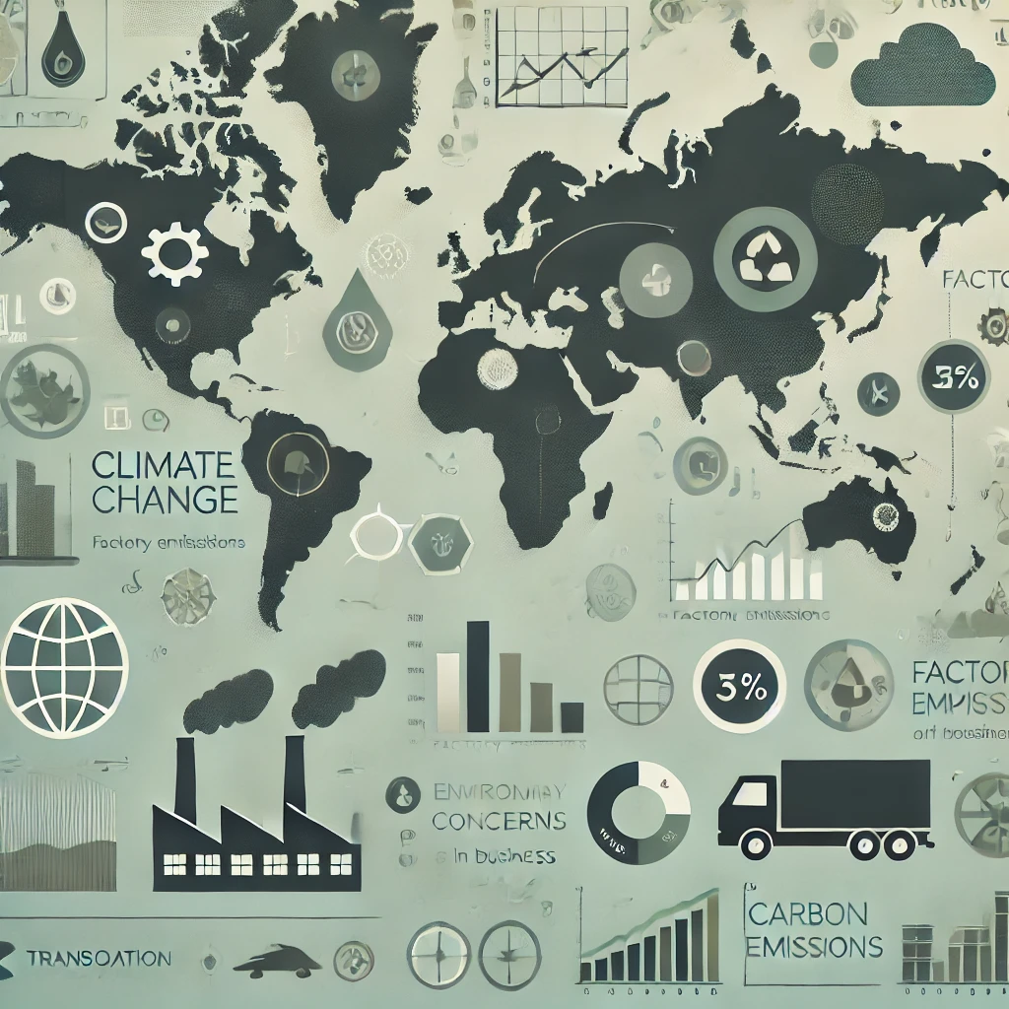
In the current era of climate change and environmental concerns, businesses face increasing pressure to reduce their carbon footprints. Many companies struggle to accurately track and manage their emissions across various operations, from production to logistics. Without proper insights into where emissions are generated and how they can be reduced, businesses risk falling behind in their sustainability goals and may face regulatory penalties. Additionally, customers and investors are increasingly leaning toward companies that demonstrate strong environmental stewardship. The absence of real-time, actionable data on carbon emissions impedes the ability of companies to implement effective and sustainable changes.

Slide 4
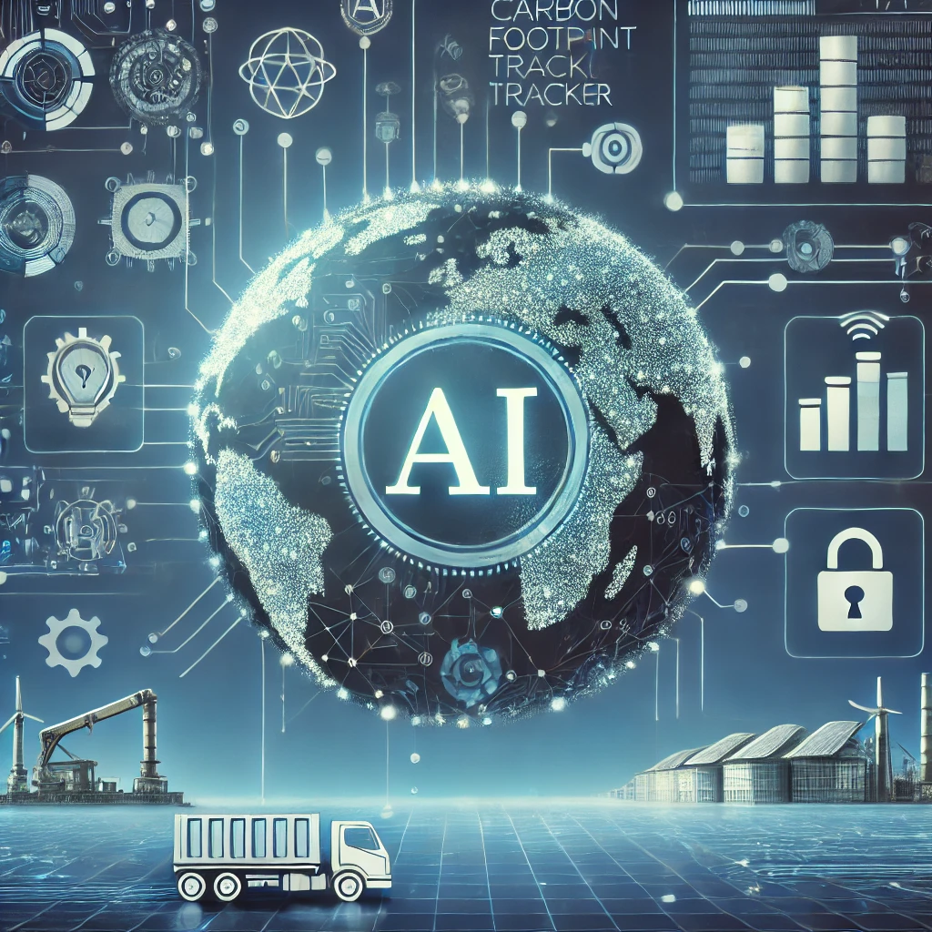
We propose an AI-based Carbon Footprint Tracker that leverages Generative AI to provide real-time analysis and insights into a company's carbon emissions. This tool integrates with the company’s existing infrastructure (such as ERP and supply chain management systems) to gather data on energy consumption, production processes, transportation, and logistics. The AI model identifies the highest contributors to carbon emissions and suggests alternatives, such as more sustainable energy sources or optimized transportation routes. Additionally, the tool can generate future projections of carbon emissions and simulate the impact of different strategies for reducing carbon output. This empowers businesses to make data-driven decisions, aligning their operations with global sustainability goals while minimizing financial and regulatory risks.

Slide 5
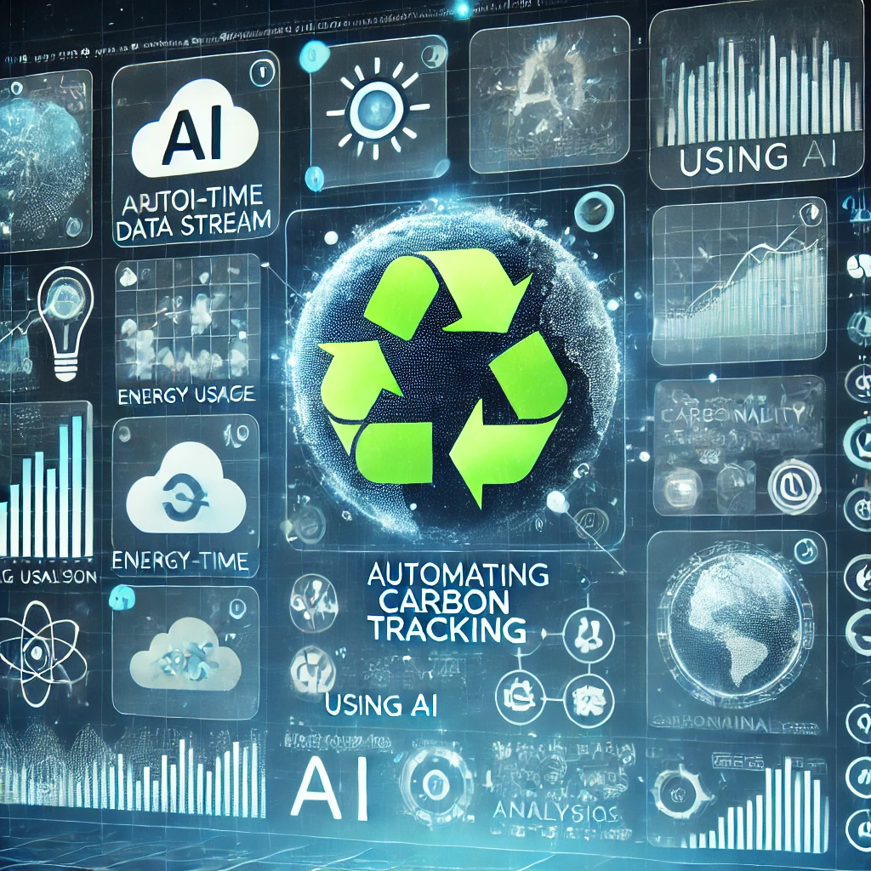
The AI-based Carbon Footprint Tracker accelerates sustainability efforts by automating complex carbon-tracking processes. Traditionally, tracking carbon emissions has been a manual, time-consuming process prone to human error. Our solution uses AI to analyze large datasets in real-time, offering immediate insights into where emissions are highest and what changes can be made. The integration of Generative AI allows the system not only to track current emissions but also to forecast future environmental impacts, which helps businesses plan more effectively for the long term. This technology enables companies to respond quickly to environmental challenges, optimize resource usage, and ensure compliance with international regulations. By leveraging AI, businesses can make smarter, faster decisions that align with their environmental, social, and governance (ESG) goals.

Slide 6
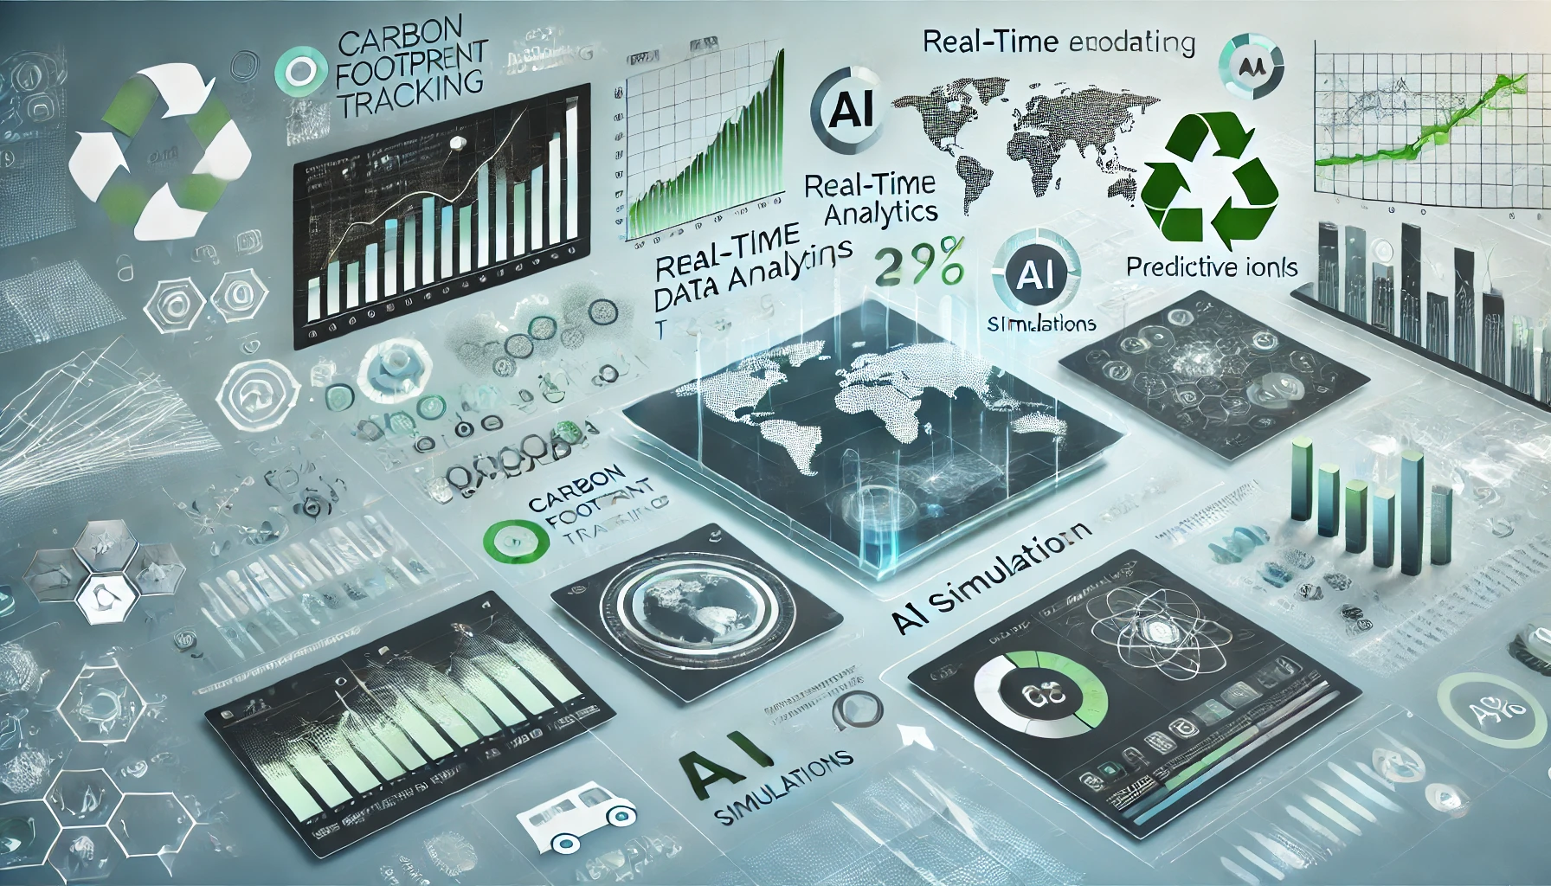
While several carbon footprint trackers exist, the use of Generative AI makes this solution unique. Traditional tools typically offer only static reports or historical data. In contrast, our AI-based tracker provides real-time tracking, predictive analytics, and scenario modeling. By simulating various strategies for reducing carbon output, the AI helps businesses visualize the long-term impact of their decisions before making any changes. Additionally, our solution integrates seamlessly with existing company systems, ensuring ease of use and minimal disruption to daily operations. This focus on real-time adaptability and foresight sets our product apart from competitors.

Slide 7
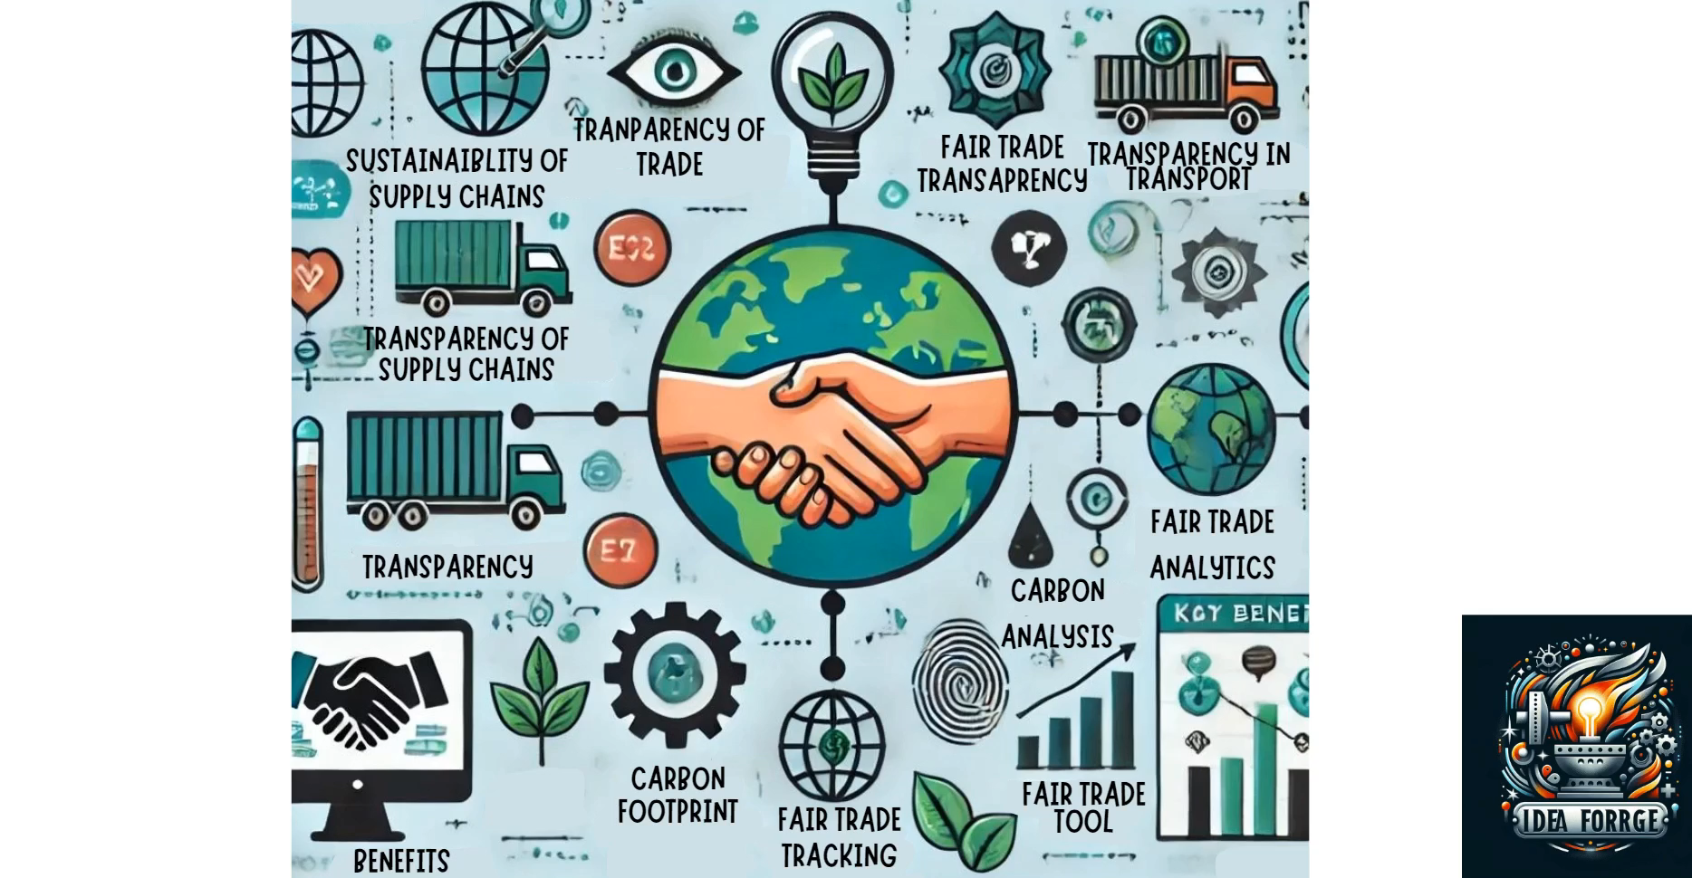
https://drive.google.com/file/d/15zkzNsBwcgKbg49oqFxxBAa8fOI9THrN/view?usp=sharing

Slide 8
Thank you!

